Slide 1
Pixel Classification using MLE
Nien-Shao Wang
COGS 118B

Slide 2
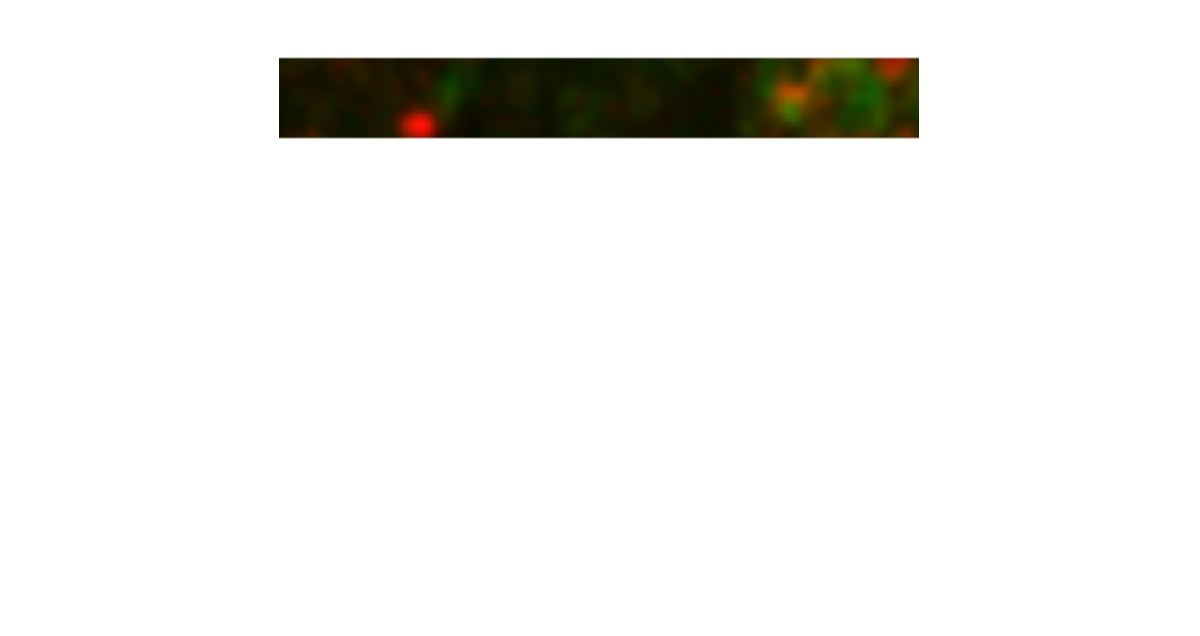
Introduction/Motivations
Identifying certain neurotransmitter activities in the lateral habenula
Two neurotransmitters: GABA (controlled by enzyme GAD) and glutamate (controlled by transporter vlugt2)
low GABA = depression
Source¹

Slide 3
Introduction/Motivations
Identify “single” and “co-label”
Single (red) = vglut2 activity
co-label = both
2 dimension (R, G). Blue already set to 0

Slide 4
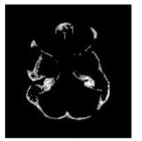
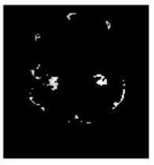
Related Work
Image segmentation on brain images
Source²: (Xie and Tsui)
Vs.

Slide 5
Image Overview
30, 50, 100, 200 training images
30 testing images
Dimension: 32 x 256
RGB images but B channel set to 0

Slide 6
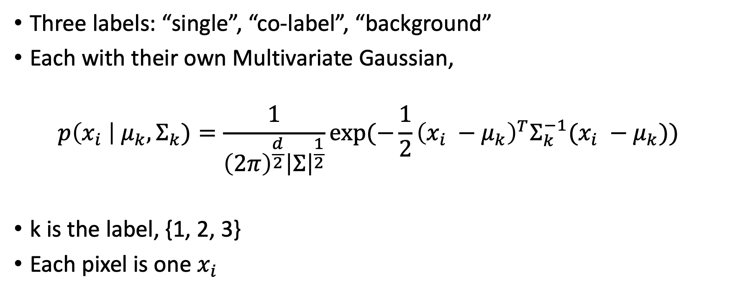
Multivariate Gaussian Distribution
Three labels: “single”, “co-label”, “background”
Each with their own Multivariate Gaussian,
$$p\left(x_{i} \right| μ_{k}, Σ_{k})=\frac{1}{{\left(2π\right)}^{\frac{d}{2}}{\left|Σ\right|}^{\frac{1}{2}}}exp⁡(−\frac{1}{2}{\left(x_{i} −μ_{k}\right)}^{T}Σ_{k}^{−1}(x_{i} −μ_{k}))$$
k is the label, {1, 2, 3}
Each pixel is one $x_{i}$

Slide 7
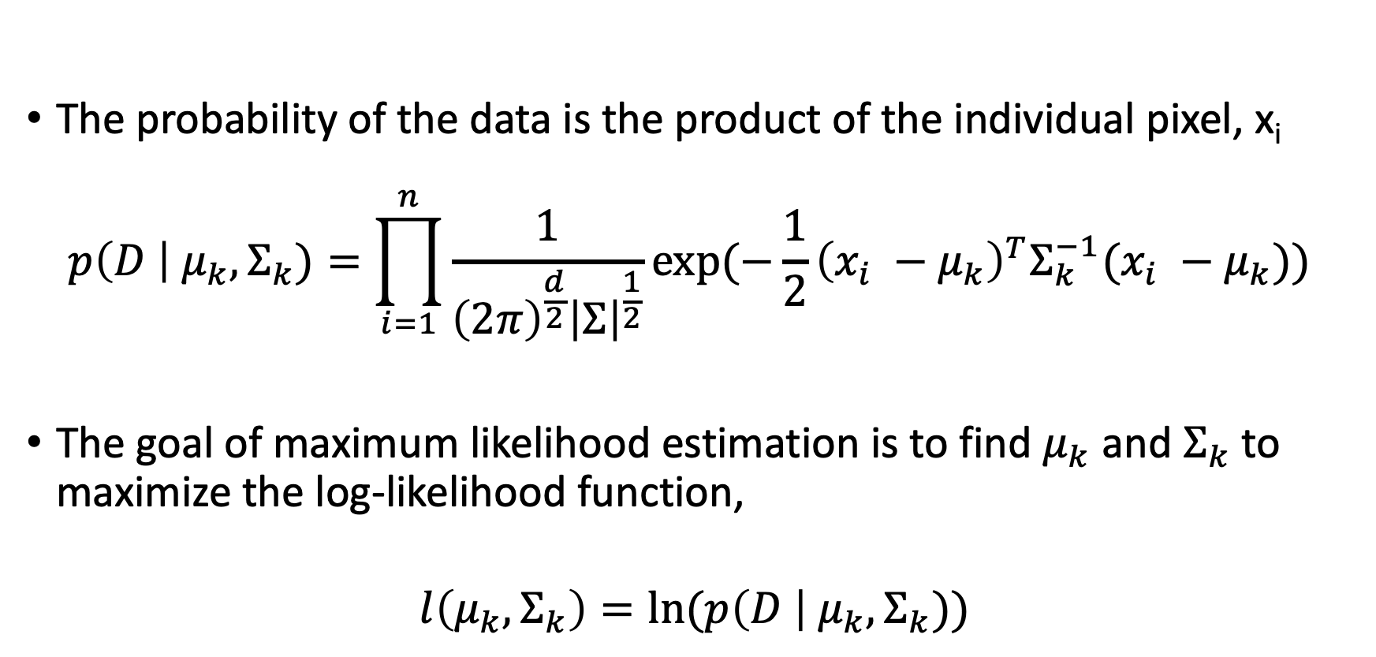
Multivariate Gaussian Distribution (MLE)
The probability of the data is the product of the individual pixel, x_{i}
$$p\left(D \right| μ_{k}, Σ_{k})=\prod_{i=1}^{n}{\frac{1}{{\left(2π\right)}^{\frac{d}{2}}{\left|Σ\right|}^{\frac{1}{2}}}exp⁡(−\frac{1}{2}{\left(x_{i} −μ_{k}\right)}^{T}Σ_{k}^{−1}(x_{i} −μ_{k})) }$$
The goal of maximum likelihood estimation is to find $μ_{k}$ and $Σ_{k}$ to maximize the log-likelihood function,
$$l\left(μ_{k},Σ_{k}\right)=ln⁡(p\left(D \right| μ_{k}, Σ_{k}))$$

Slide 8
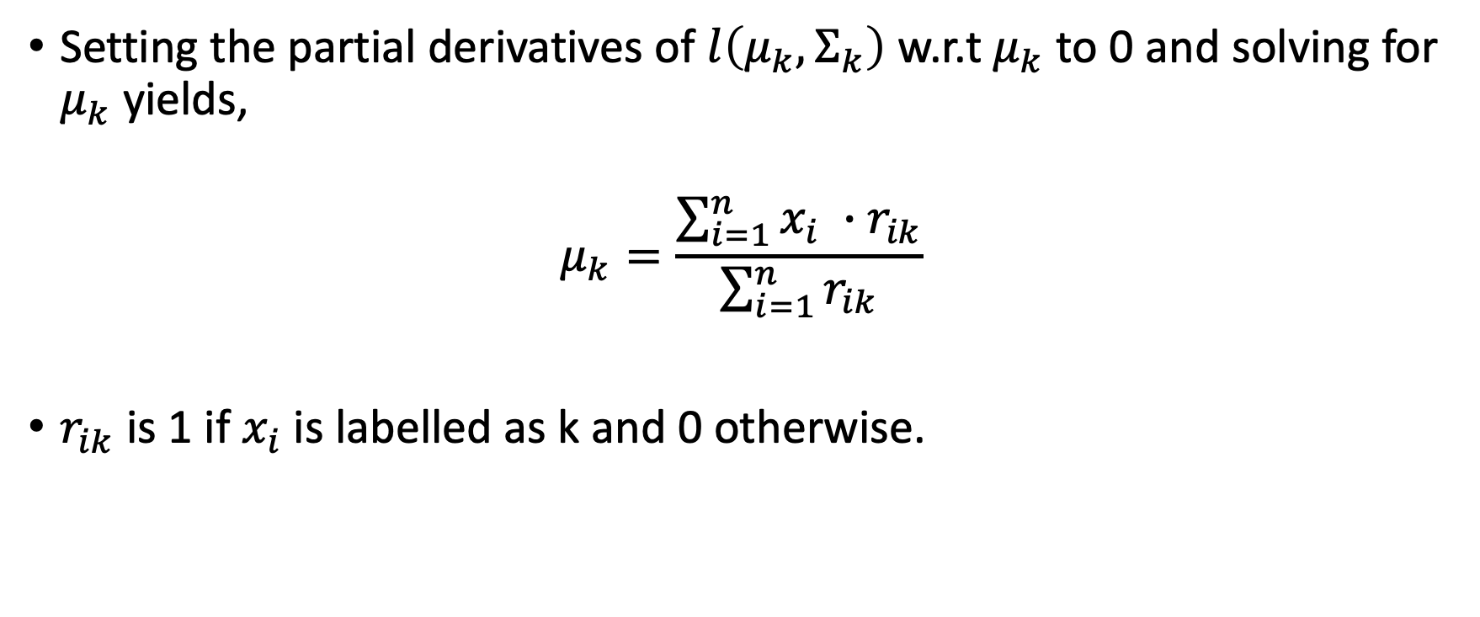
Maximum Likelihood Estimation (Mean)
Setting the partial derivatives of $l\left(μ_{k},Σ_{k}\right)$ w.r.t $μ_{k}$ to 0 and solving for $μ_{k}$ yields,
$$μ_{k}=\frac{\sum_{i=1}^{n}{x_{i} ∙r_{ik}}}{\sum_{i=1}^{n}{r_{ik}}}$$
$r_{ik}$ is 1 if $x_{i}$is labelled as k and 0 otherwise.

Slide 9

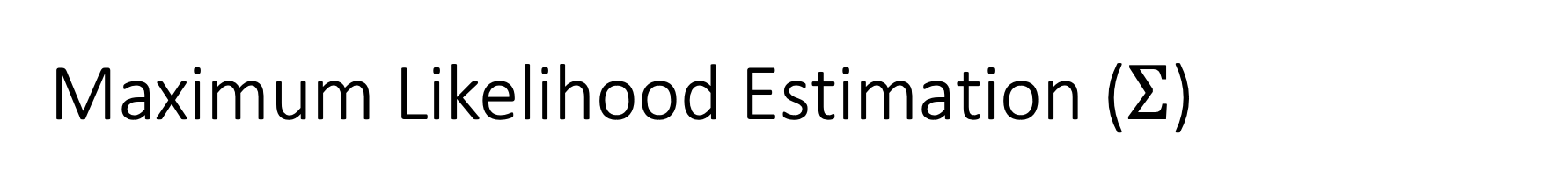
Maximum Likelihood Estimation ($Σ$)
Using the mean found, the covariance matrix can be calculated using,
$$Σ_{k}=\frac{\sum_{i=1}^{n}{\left(x_{i} − μ_{k}\right){\left(x_{i} − μ_{k}\right)}^{T} ∙ r_{ik}}}{\sum_{i=1}^{n}{r_{ik}}}$$

Slide 10

Classification
Now that the optimal parameters $μ_{k},Σ_{k}$ are found, each pixel of the images in the test set is determined using,
$label=argmax p\left(x^{′} \right| label=k)$

Slide 11

How accurate is it?
To determine accuracy, the following equation is used,
$$accuracy=\frac{\sum_{i=1}^{n}{1 (if measured label=actual label)}}{size of test set}$$

Slide 12
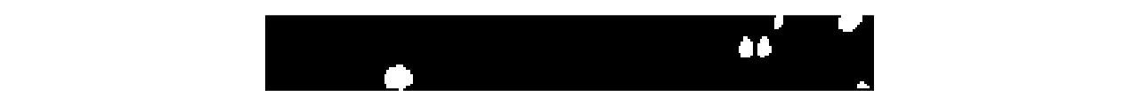
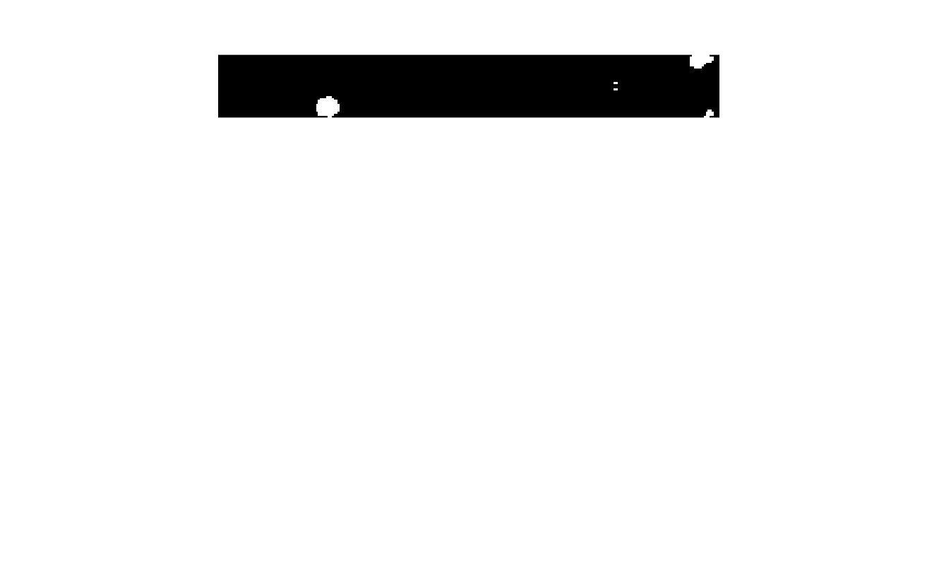
Results
Image
Actual Mask
Predicted Mask

Slide 13
Results
Training size (# of image) | Accuracy
30 | 0.8953
50 | 0.8987
100 | 0.8936
200 | 0.8826

Slide 14
Observations
Lower accuracy when increasing training size
Overfitting?
The ratio between “single” and “co-label” are not the same across all images
Underfitting?

Slide 15
Improvements / Other models
Possibly examine the 2 layers individually
Bayesian Method
PCA
Neural Network

Slide 16
Acknowledgement
Steven Shabel
Roberto Malinow
TA Sambaran
Prof. De Sa

Slide 17
Reference
1. Shabel, Steven J, et al. “Mood Regulation. GABA/Glutamate Co-Release Controls Habenula Output and Is Modified by Antidepressant Treatment.” Science (New York, N.Y.), U.S. National Library of Medicine, 19 Sept. 2014, https://www.ncbi.nlm.nih.gov/pmc/articles/PMC4305433/.
2. Xie, J, and H.T Tsui. “Image Segmentation Based on Maximum-Likelihood Estimation and Optimum Entropy-Distribution (Mle–OED).” Pattern Recognition Letters, vol. 25, no. 10, 2004, pp. 1133–1141., https://doi.org/10.1016/j.patrec.2004.03.013.

